Slide 1
The task is to make a presentation (15 min), in which students are required to demonstrate the following:
Briefly introduce the background of this company, e.g., its competitive situation, innovation challenge, and future strategy, etc.
Very briefly clarify the innovation tool(s) (its concept and application in general) that you chose as relevant for the case company. Do it very briefly, because we have learned all the tools during the previous 2 presentation sessions.
Explain how the innovation tool(s) is/are relevant to this company.
Extensively discuss the actual application of (or potential opportunity to apply) the tool(s) to the case company and to what extent change can be expected. If in practice it is not possible to actually apply a tool to the case company (see other forms of “relevance” defined), then you must deliberate on, for instance, how the company is currently practicing, based on which type of innovation tools/process/frameworks, and why and how the relevant tools you learned from the course can benefit the company and what have you learned from investigating the company.
Reflect on relevant theoretical aspects behind the application of the tool(s) to the company in a specific context. For instance, if you choose a tool that aims at reducing risks, you should discuss a bit on risk reduction; if you chose a tool that aims at combining customer needs to product functions, you need to discuss a bit about the importance and challenges to combine market and technology, etc.

Slide 2
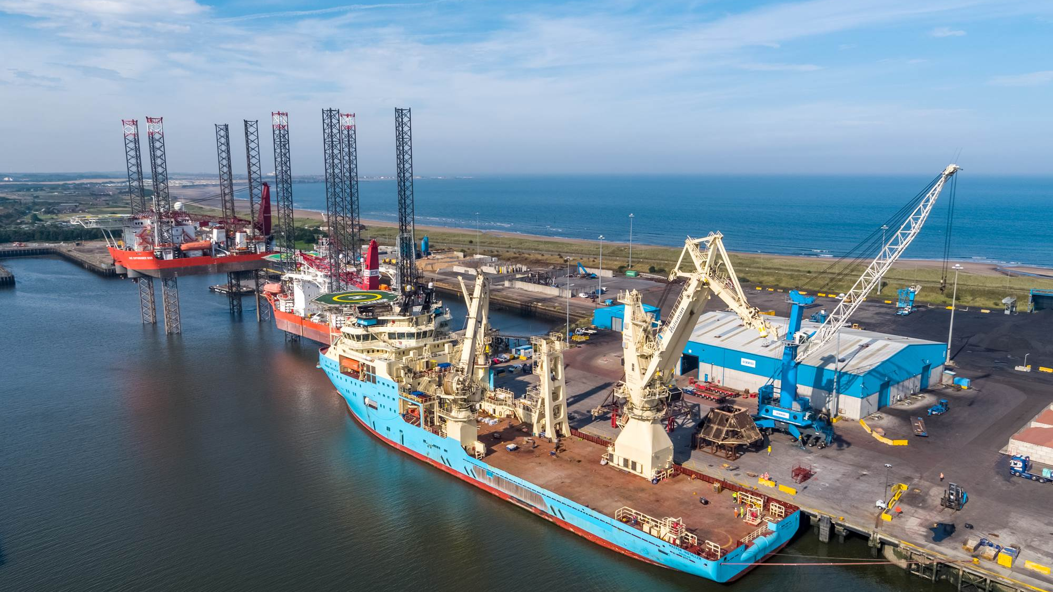

Maersk Decom
Company case presentation

Slide 3
Who are Maersk Decom

Slide 4
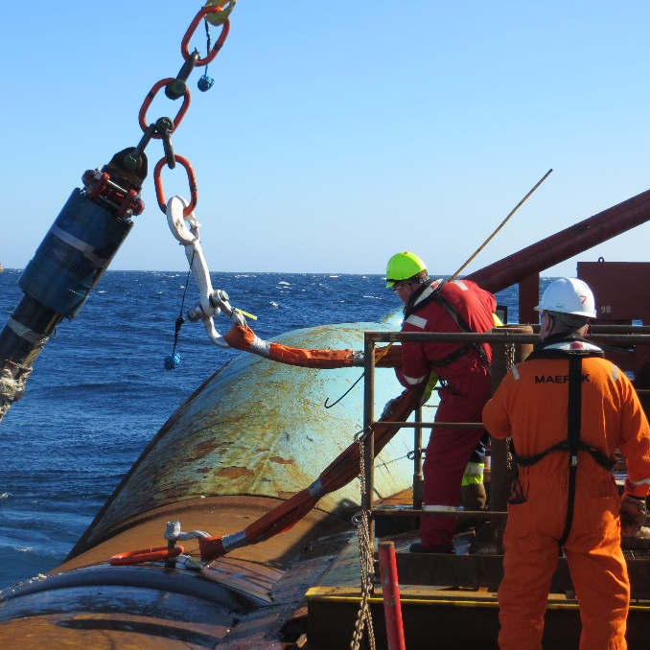
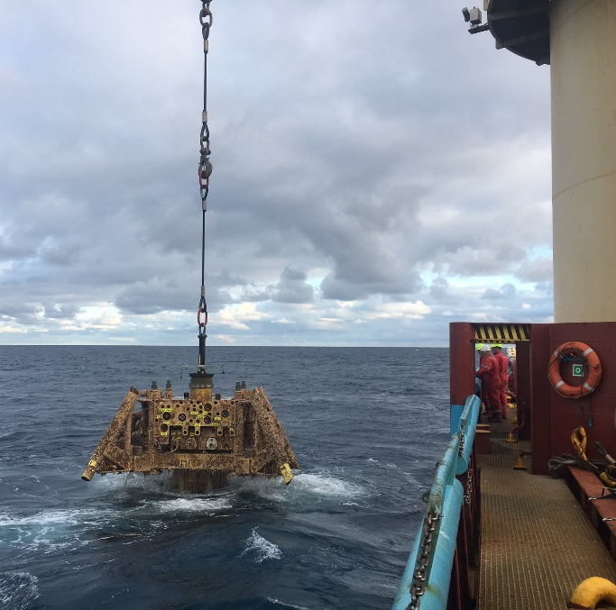
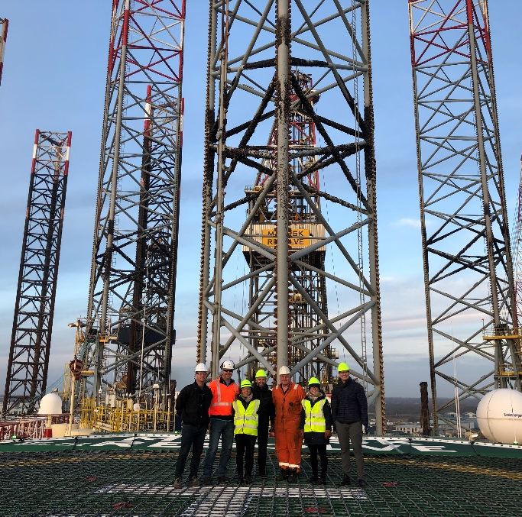
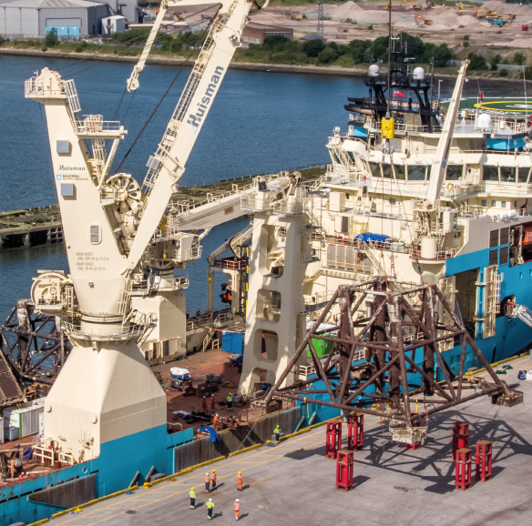
History: Creating a joint venture
2016
2017
2018
2019
Maersk Drilling and Maersk Supply Service begin decommissioning of the Janice, James and Leadon fields in the UK North Sea for Maersk Oil.
Efficiencies seen during the Janice, James and Leadon decommissioning project lay the foundation for creating Maersk Decom.
Maersk Decom launched April 8 as a 50:50 joint venture between Maersk Drilling and Maersk Supply Service to provide decommissioning solutions to the offshore energy industry.
Maersk Decom executes its first project with the removal, recycling and waste management of subsea infrastructure for the Thames field.

Slide 5
Maerks Decom's mission
"We are a dedicated team of experts in the field who are committed to constant improvement – incorporating learnings from every project we work on into the project at hand. We address key issues such as predictability of costs, risk, compliance, sustainability and reputation.
To do it, we draw upon more than 50 years of experience and assets from the offshore support vessel and drilling industries. And we deliver it all as one integrated team including project management and engineering."
The dedicated decommissioning partner for the offshore energy industry.

Slide 6
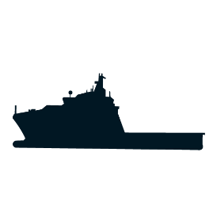




Vision:
Targeting waste minimisation, re-use and closed loop recycling
Working together in integrated project teams
Innovative recovery methods to reduce time
Optimising plug and abandonment activities
Maximising efficiency in infrastructure removal
Constantly rethinking decommissioning to maximise value and sustainability

Slide 7


Project management
Maersk Decom deliver it all as
one integrated team, including project management
and engineering
Procurement & contract management
Baseline survey
Engineering & planning
Flushing & cleaning
Well services
& special tools
Regulatory consultation
ROV & diving operations
Scalable
Solutions
Rock dumping
Drilling
facilities & services
Disconnect & dismantling
Heavy lift
Shorebase, transport & logistics
Offshore support vessels & services
Recycling & waste management
Subject matter experts & offshore crew

Slide 8
Interviewees
Project Control Manager
Project Manager
Senior Tender Manager
Senior Commercial Manager
Supply Chain Manager
Sustainability Lead
Lack of resources
Tender structure and task assignation is not prepared in advance
Lack of coordination between departments
Leadership has problems with resource management
Not everyone using the designated tools
Level of detail unclear
Internal deadlines not met, but overall deadline is met
No task monitoring
No process standardisation
No consistent prioritisation of tasks
Frequent problem
Mentioned a couple of times
Mentioned once
Notes:
Create customer proposals across disciplines, such as technical, commercial and finance.
They are coloured in relation to how frequent they were mentioned.

Slide 9
Innovation Tool – Fishbone Diagram

Slide 10
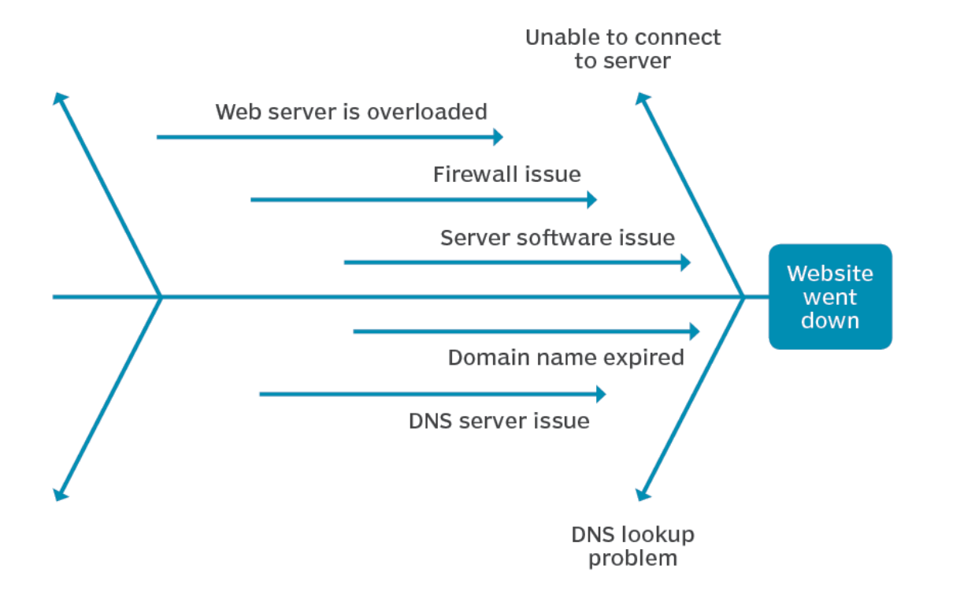
Friendly Reminder of the Fishbone diagram
When to use a fishbone diagram
A few reasons a team might want to consider using a fishbone diagram are:
To identify the possible causes of a problem.
To reveal bottleneck or areas of weakness in a business process.
To ensure that any corrective actions put into place will resolve the issue.
Notes:
We asked the interviewees if they knew the tool and they all knew it. This was also a plus because they were already familiar with it.

Slide 11
Fishbone diagram and Maersk Decom Tender Process for reply to customer
Tools
People
No Software
Poor management
Uncoherent organisational structure
Unclear functional requirements
Lack of software knowledge
Lack of communication across disciplines
Unclear role definition incl. overlap in deliverable responsibility
Lack of holistic approach to workflow
Bad prioritising
Multiple leadership for single task
Overloaded with work
End to End monitoring
Lack of alignment
No enforced tool
No agreement on one tool
Multiple software and tools in practice
Inefficient use of current tool
Unsatisfying tender process
Lack of resources
Unclear process
Unclear selection process/decision gate
Unclear reply to customer process
Unclear methodology
No specific tender mgt. workforce
Understaffed
Lack of skilled resources
Lack of software training
Unclear tender definition
Tender structure
Unclear scope clarification
No enforced procedure
Fail to meet internal deadlines
Work done accordingly to the need of the hour
Missing guidelines
No standardised submission format
Resources
Governance
Notes:
Extensively discuss the actual application of (or potential opportunity to apply) the tool(s) to the case company and to what extent change can be expected.
- how the relevant tools you learned from the course can benefit the company and what have you learned from investigating the company.

Slide 12
Fishbone diagram - People
People
Uncoherent organisational structure
Poor management
Lack of communication across disciplines
Unclear role definition incl. overlap in deliverable responsibility
Lack of holistic approach to workflow
Bad prioritising
Multiple leadership for single task
Overloaded with work
End to End monitoring
Lack of alignment
Unsatisfying tender process
Notes:
its concept and application in general
Explain how the innovation tool(s) is/are relevant to this company.

Slide 13
Fishbone diagram - Tools
Tools
No Software
Unclear functional requirements
Lack of software knowledge
No enforced tool
No agreement on one tool
Multiple software and tools in practice
Inefficient use of current tool
Unsatisfying tender process
Notes:
its concept and application in general
Explain how the innovation tool(s) is/are relevant to this company.

Slide 14
Fishbone diagram - Governance
Unsatisfying tender process
Unclear process
Unclear selection process/decision gate (ITT)
Unclear reply to customer process
Unclear methodology
Unclear tender definition
Tender structure
Unclear scope clarification
No enforced procedure
Fail to meet internal deadlines
Work done accordingly to the need of the hour
Missing guidelines
No standardised submission format
Governance
Notes:
its concept and application in general
Explain how the innovation tool(s) is/are relevant to this company.

Slide 15
Fishbone diagram – Financial Resources
Unsatisfying tender process
Lack of resources
No specific tender mgt. workforce
Understaffed
Lack of skilled resources
Lack of software training
Resources
Notes:
its concept and application in general
Explain how the innovation tool(s) is/are relevant to this company.

Slide 16
Theoretical aspects

Slide 17




Relevancy
Why is the Fishbone diagram "Relevant" to the case study ?
- Probe deeper to the current situation
Current situation : "The company has heard about the usefulness of the tool but has been reluctant to implement it for some reasons"
Insights from the tool:
- The respective tool helps teams generate a deep and system-level understanding as a foundation for effective solutions.
- This analysis also serves as a visual way to prioritize, communicate and track how to act on the team’s findings.
- It helps reveal the relations between a problem identified in a process and its potential causes.

Slide 18
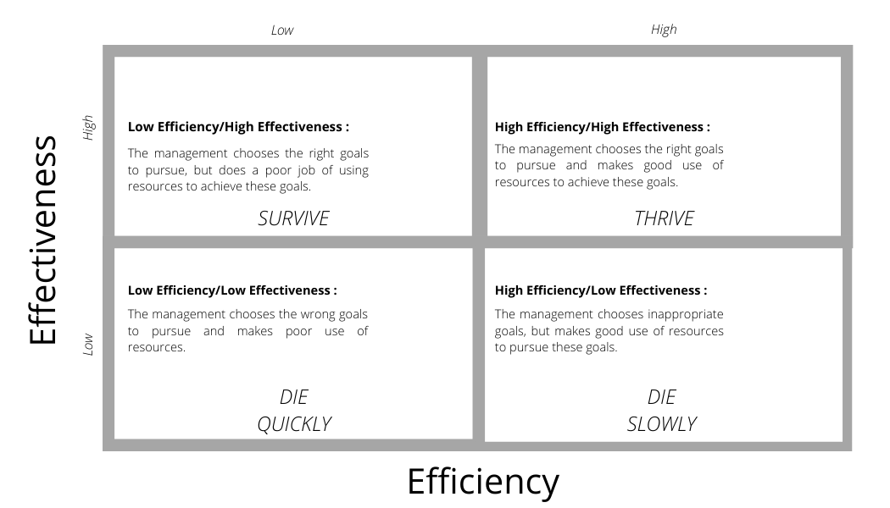

Current state vs Future state :

Slide 19
Reflection
The framework shows a visual representation of complex and inter-related factors driving the tender process with a cause-effect approach over the long run.
Fishbone diagram becomes a very useful instrument in risk identification.
- Extending the applicability of the method.
- Including analysis of the impact.
- Allowing to determining the risk score for each category.

Slide 20
Questions ?
Thank You

